Slide 1

Answer: 6 in 10 Australian said they are. (Source: Michael Page studies- “Make 2022 the Year of Opportunities)
When COVID happened, have you had a thought of changing careers? Are you planning to make a move in the next 6 months?
Impact of COVID on Australian Employment

Slide 2
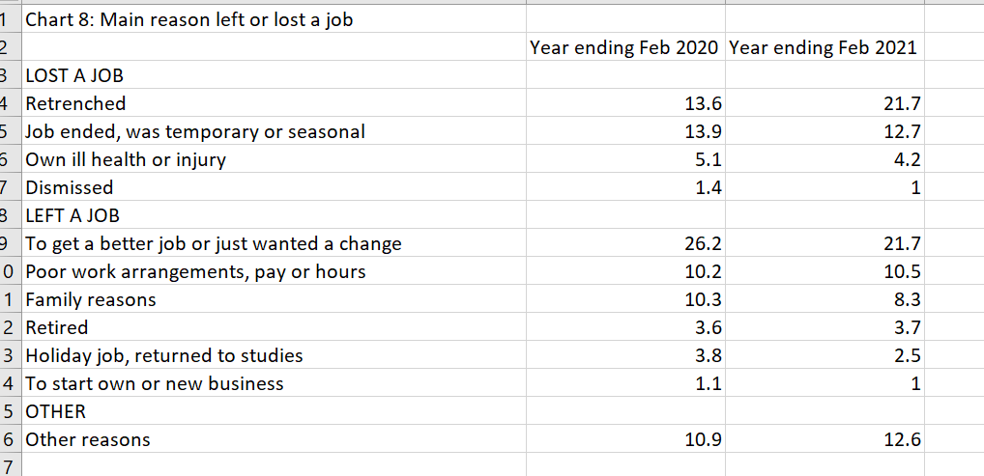
Pie chart here

Slide 3
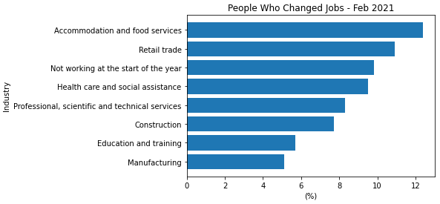
Changing Jobs
Data is from ABS - Job Mobility (Year Ending February 2021)
This figure shows that 12% of those working under Accommodation and Food Services decided to change jobs, next was Retail which was 11% and Health Care was 9.5%.

Slide 4
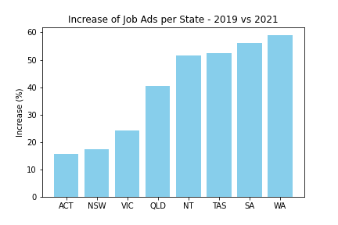
Job Ads by State
Internet Vacancy Index (IVI) which is a monthly count of online job advertisements compiled by the National Skills Commission through job boards such as Seek, CareerOne and Australian JobSearch. (https://labourmarketinsights.gov.au/our-research/internet-vacancy-index/#3)
Comparing the total vacancies between 2019 vs 2021, Western Australia had a growth of 59%.

Slide 5
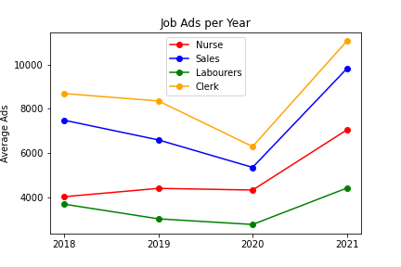
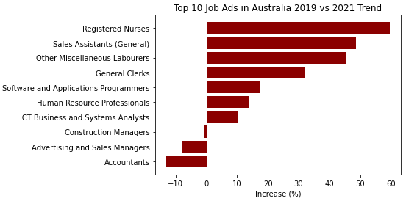
Job Vacancies
Below are the top 10 job roles with the most job advertisements across Australia.
Looking between 2019 and 2021, Registered Nurses (59%), Sales Assistants (48%), Labourers (45%) and General Clerks (32%) are the job roles that had a significant increase.

Slide 6
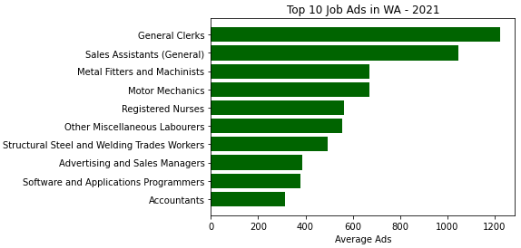
Job Ads in Western Australia
Occupations with the most job ads in WA are General Clerks (1200), Sales Assistants (1050), Metal Fitters and Machinists (670).

